Slide 1
Module 3 (Part II)
Writing Unit Tests

Slide 2
Index
Writing tests with Assertions
Defining and using Custom Assertions
Single condition tests
Testing for expected errors
Abstract test

Slide 3
Introduction
The previous sections present a simple unit test framework and the fundamentals of xUnit
The unit test framework’s architecture is important to understand
Most of your time should be spent writing unit tests, implementing production code to make the tests pass, or refactoring
This section includes examples of common patterns used when writing unit tests, as well as related tips on unit test development

Slide 4
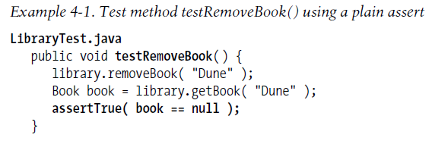
Writing tests with Assertions
The code examples shown so far use plain asserts
These are the most generic type of test assertion, which take a Boolean condition that must evaluate to TRUE for the test to succeed
A plain assert, the unit test for the Library method removeBook(), is shown in Example 4-1

Slide 5
Although the line of code where the failure occurred is shown, the output does not describe the specific cause of the failure
It often is helpful to add an informative message to the assertion
The xUnits generally have two versions of every assert method, one of which takes a message parameter describing the assert
Example 4-2 shows the test method using an assert with a message

Slide 6
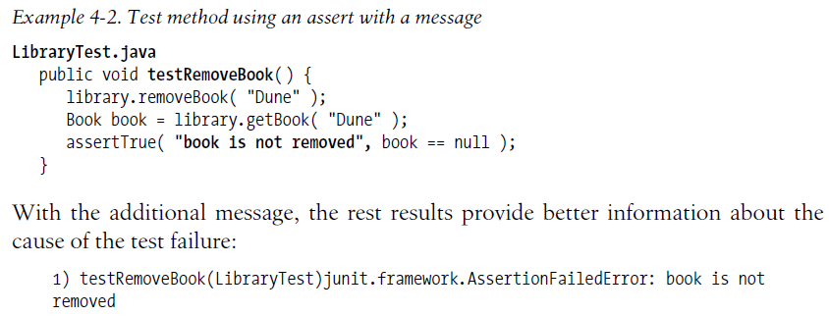

Slide 7
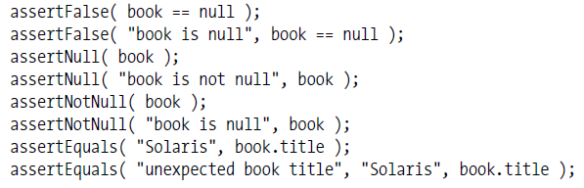
Although all assert conditions ultimately must evaluate to a Boolean result of TRUE or FALSE, it can be tedious to constantly reduce every expression to this form
The xUnits offer a variety of assert functions to help
Examples of several of the assert methods from JUnit are as follows:
These assert methods all have variants that take a message parameter to describe the failure, as shown above
The assertEquals() method has variants that take different data types as arguments

Slide 8
Defining and using Custom Assertions
The basic assert methods cover only a few common cases
It’s often useful to extend them to cover additional test conditions and data types
Custom assert methods save test coding effort and make the test code more readable
So far, the Library tests check a Book’s title attribute to verify the expected Book object, as shown in Example 4-3 in the test method testGetBooks()

Slide 9
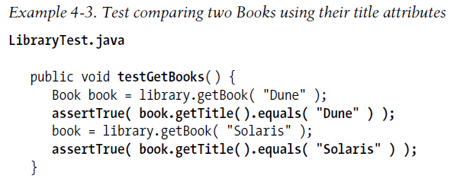

Slide 10
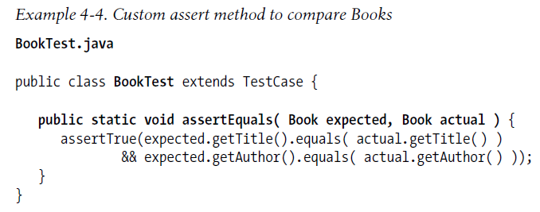
It’s clearly useful to have an assert method that compares an expected Book to the actual Book, checking all of the attributes
This new assert method is easy to implement by building on the generic assertTrue() method, as shown in Example 4-4

Slide 11
The assert method assertEquals() takes expected and actual Book objects to compare
It succeeds if the title and author attributes of the two Books are equal
Example 4-5 shows how it is used

Slide 12
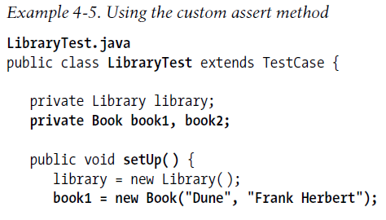
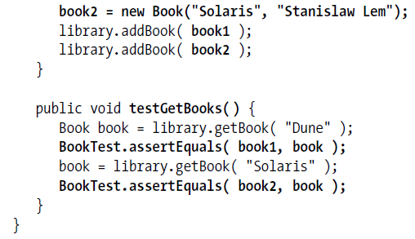

Slide 13
Single condition tests
The idea is that a test method should only test one behavior
If there is more than one assert condition, multiple things are being tested
When there is more than one condition to test, then a test fixture should be set up, and each condition placed in a separate test method

Slide 14
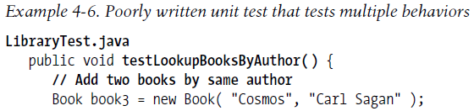
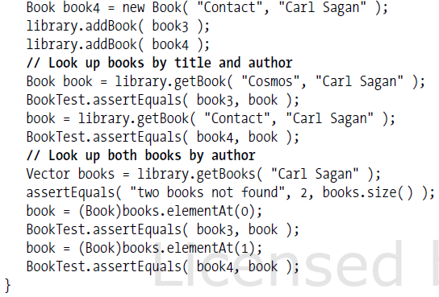

Slide 15
It tests two separate behaviors: getting a Book by author and title and getting multiple Books by the same author
Looking up two books by two different methods means there are several results to test; thus, there are many asserts - five in all
The complexity of the changes increases the chance that a coding mistake will be made
If the Book lookup by title and author fails, it has to be fixed before the test that gets multiple Books is run
In other words, the tests are coupled so that failure of one may affect the success of the others

Slide 16
When the number of asserts in a test method is excessive, change it into a test fixture with multiple test methods, each testing one behavior
In Example 4-7, refactoring the test method makes it apparent that the two lookup methods are distinct behaviors and should be tested separately
Example 4-7 shows LibraryTest with the two separate test methods, one for each behavior
The code to add the two test Books is placed in the setUp() method
The tests are isolated and the code is simplified

Slide 17
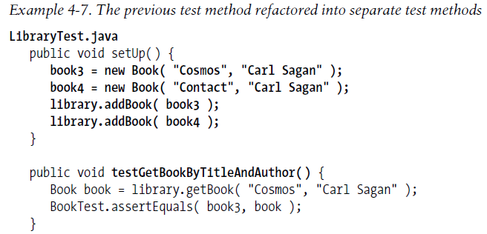
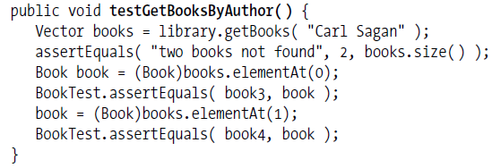

Slide 18
Testing for expected errors
It is important to test the error-handling behavior of production code in addition to its normal behavior
Such tests generate an error and assert that the error is handled as expected
In other words, an expected error produces a unit test success
The canonical example of a unit test that checks expected error handling is one that tests whether an expected exception is thrown, as shown in Example 4-8

Slide 19
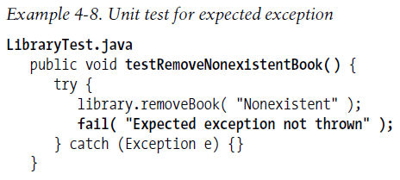

Slide 20
The expected error behavior is that an exception is thrown when the removeBook() method is called for a nonexistent Book
If the exception is thrown, the unit test succeeds
If it is not thrown, fail() is called
The fail() method is another useful variation on the basic assert method
It is equivalent to assertTrue(false), but it reads better

Slide 21
Abstract test
Just like regular classes, abstract classes and interfaces should have their own unit tests
An AbstractTest contains an abstract factory method, which produces an instance of the object to test
It also contains the test methods for the abstract class
They resemble ordinary unit test methods, but test instances of the abstract class created by the factory method

Slide 22
To test a concrete class that is descended from the abstract class, the unit test is subclassed from the AbstractTest
Its factory method returns an instance of the concrete class
When the concrete unit test is run, the AbstractTest is run as well
So, the AbstractTest tests every concrete implementation of the abstract class
Let’s create an AbstractTest for the interface DBConnection
We’ll add the method isOpen() to it, as shown in Example 4-18

Slide 23
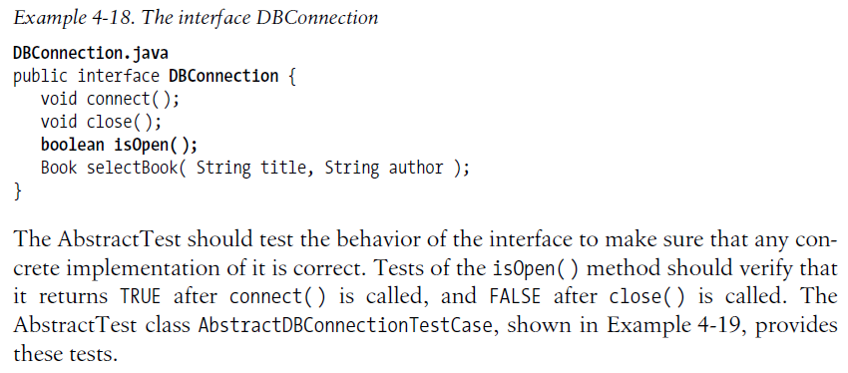

Slide 24
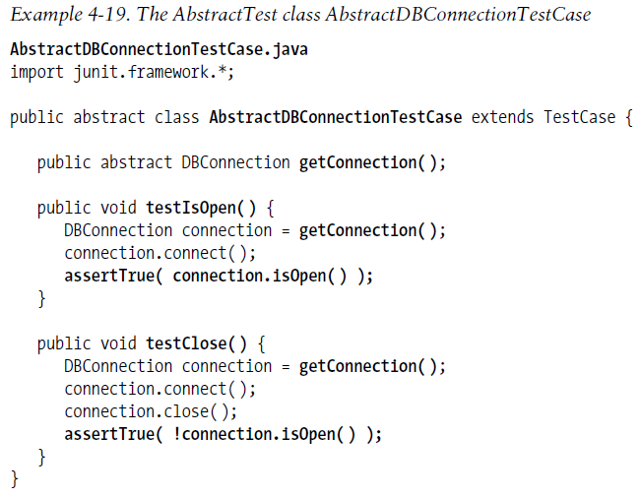

Slide 25
The AbstractTest specifies a factory method, getConnection()
Concrete tests that descend from it will implement the factory method, allowing the test methods testIsOpen() and testClose() to test an instance of the concrete class
Notice how these methods use getConnection() to get the DBConnection to test

Slide 26
To see the AbstractTest run, we need to define a concrete class descended from DBConnection and a corresponding concrete unit test descended from AbstractDBConnectionTestCase
The concrete class JDBCConnection is shown in Example 4-20

Slide 27
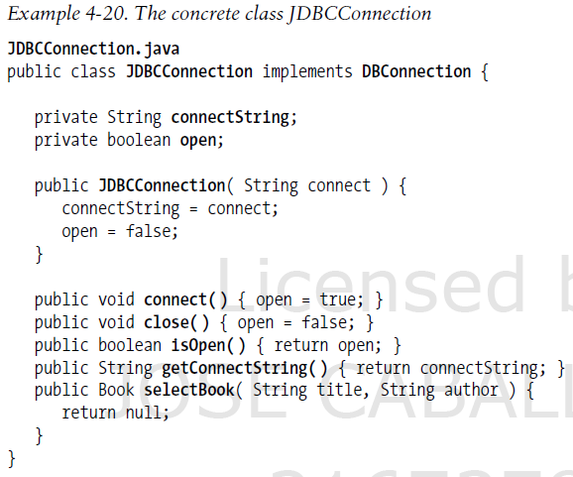

Slide 28
JDBCConnection is an initial version of an interface to a JDBC database engine
It differs from the base DBConnection by its member connectString, which contains the URL of a JDBC database connection
The unit test JDBCConnectionTest tests JDBCConnection
It is derived from the AbstractTest
It is shown in Example 4-21

Slide 29
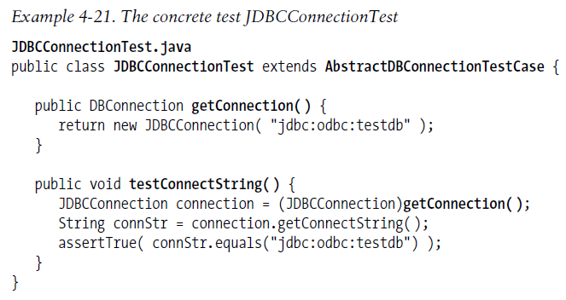

Slide 30
JDBCConnectionTest implements the factory method getConnection() and one test method, testConnectString()
When the test is instantiated and run, the two test methods in the parent AbstractTest also will be run to test instances of JDBCConnection
This way, the AbstractTest verifies that the concrete subclass passes the tests of the parent interface

